Slide 1
The Female Divine 101
(for seniors)
Levon Ani Marlen Toni Laura Drew Yesenia

Slide 2
Course calendar
Week 1 - Levon
Intro to Mythology and Myth Article
Week 2 - Ani
The Female Divine and The Myth of Callisto and Arcas
Week 3 - Marlen and Toni
Discussion on Pop Culture and Mini Project
Week 4 - Laura
Discussion on Oppressed Women and Introduction to Personal Project
Week 5 - Drew
Presentations on Personal Project and Class Discussion
Week 6 - Yesenia
Final Essay Assigned and Learning Outcomes

Slide 3
Week 1 - introduction to mythology
Ask the class what they think mythology is?
What is mythology?
Discuss the basic information.
Discuss a little on the myths of Rome (Italy) for our myth (THIS IS IMPORTANT! To identify the different kinds of myths) you can find info on roman myths in the intro of the myth on callisto and arcas
Tie in mythology article.
Discuss how the article ties into this discussion.

Slide 4
Myths
Why were Myths created
Archetypes seen in myths
Similarities and differences of types of myths
Evolution of myths

Slide 5
Mythology as we see it
“It can consist of modes of writing or of
representations; not only written discourse, but also
photography,cinema, reporting, sport, shows, publicity”
(Barthes 108)

Slide 6
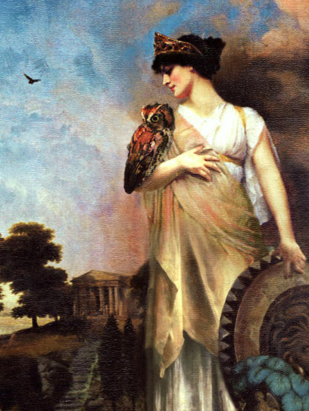
Week 2 - the female divine
“It represents the supreme level of feminine expression and manifestation in the universe” (Satchitananda 1).
Attributes: Mother, Power, Love, Death, Nature, Civilization.
Seen in many different forms in works; Mostly as deities.
Stories of goddesses include “the 3 stages of a woman’s life cycle: Life, Death, and Regeneration” (Leonard 113).

Slide 7
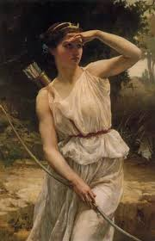
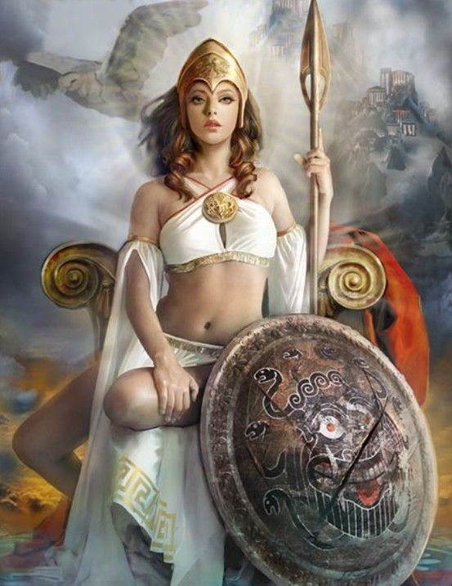
Goddesses of life - The Universal Womb
They birth, feed, teach, care for, and guard all living things.
They are protectors, warriors, law-givers, architects, agriculturalists, performers, etc.
“...are depictions of the Goddess as Great Mother...the ground from which we derive sustenance and the creator of all life upon it” (Leonard 114).
Athena: Goddess of War
Artemis/Diana: Goddess of the Hunt

Slide 8
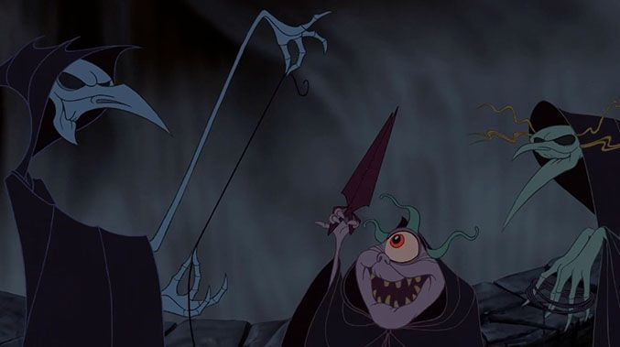
Appear in myths as witches, mediums and old wise woman.
They are operators of fate.
goddesses of death - goddesses of the underworld
Clotho → the spinner (right)
Lachesis → The measurer (left)
Atropos → the cutter (center)
Zeus’s three daughters who spin the threads of life are called the Moirae.

Slide 9
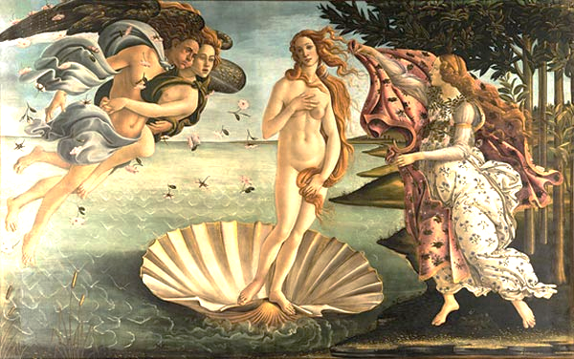
Goddesses of regeneration
Goddesses of love, sexual desire, and beauty.
Appear as virgins and nymphs in mythology.
“Their pulsing sexual energies impel mortal creation to renew itself, and thus their influence redeems individual morality through beauty, passion, and offspring” (Leonard 121).
Aphrodite: The Goddess of Love

Slide 10
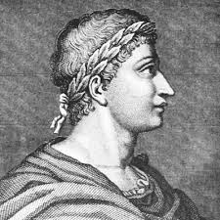

Ovid’s metamorphoses
Ovid was a Roman Poet who wrote very controversial books
He wrote Ars Amatoria → a how-to book on seducing woman.
Lastly came Metamorphoses which is considered to be a very gender political book.
In the book he depicts gods and rulers as shameless and feel no guilt when committing adultery, rape, lying, etc.
In a chapter of the book, he tells the myth of Callisto and Arcas which has been known to have multiple versions in different myths.
Watch “Great Greek Myths” Season 1 Episode 2: Zeus in Love on Amazon Prime Video
https://www.amazon.com/gp/video/detail/B07HNQFP2X/ref=atv_hm_hom_1_c_iEgOEZ_2_1

Slide 11
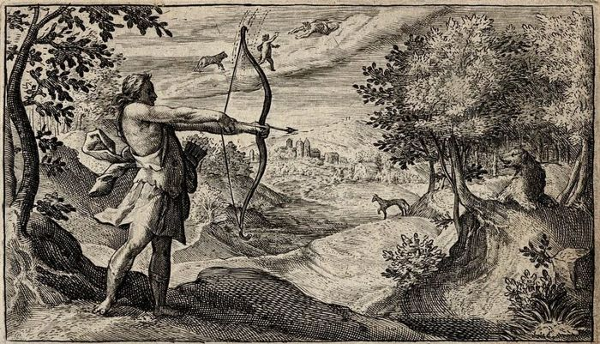
Callisto and arcas
Callisto: Young virgin nymph a part of Diana’s/Artemis’ group of nymph warriors
Diana/Artemis: leader of the nymphs; banishes Callisto for breaking her chastity
Zeus/Jove: rapes Callisto in the form of Diana; turns Callisto into the constellations of Ursa Major and son Ursa Minor
Hera/Juno: turned Callisto into a bear for “sleeping” with Zeus and giving birth to a bastard child.
Arcas: Callisto’s and Zeus’s son who tries to kill his mother when she was a bear.
Discussion: Who are the female divines? What are your thoughts on Artemis/Diana, a warrior woman, and Hera, the queen of heaven, enforcing chastity rules and yet, punishing Callisto for being raped; even though, it was Zeus who acted against that sanctity?

Slide 12
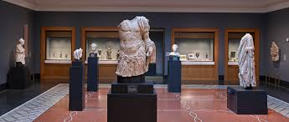
Extra Credit - visit the getty villa
Visit the Getty Villa in Malibu, California.
Specifically visit the “Greek and Roman Deities at the Villa” collection on the map.
Take a photo of you with your favorite exhibit. Do not forget! The picture is needed for credit!!
Write a page as to: Why you picked that exhibit? What stood out to you the most about it? Did you enjoy this trip? What did you learn?
Here’s a handout of all the exhibits from the Villa’s collection on Greek and Roman Deities.Some of these exhibits may not be present so make sure you write on something that is there.The handout has the exhibits gallery/room numbers!
https://www.getty.edu/education/teachers/trippack/downloads/vsi_talkshow_previsit_deities_villa.pdf

Slide 13
Week 3 - the female divine in popular culture
What is popular culture?
Where is the female divine seen in popular culture?
Explain the short mini project that will be done in class.
Present projects.
After project is done, discuss why the project was beneficial and relevant to the topic and why?

Slide 14

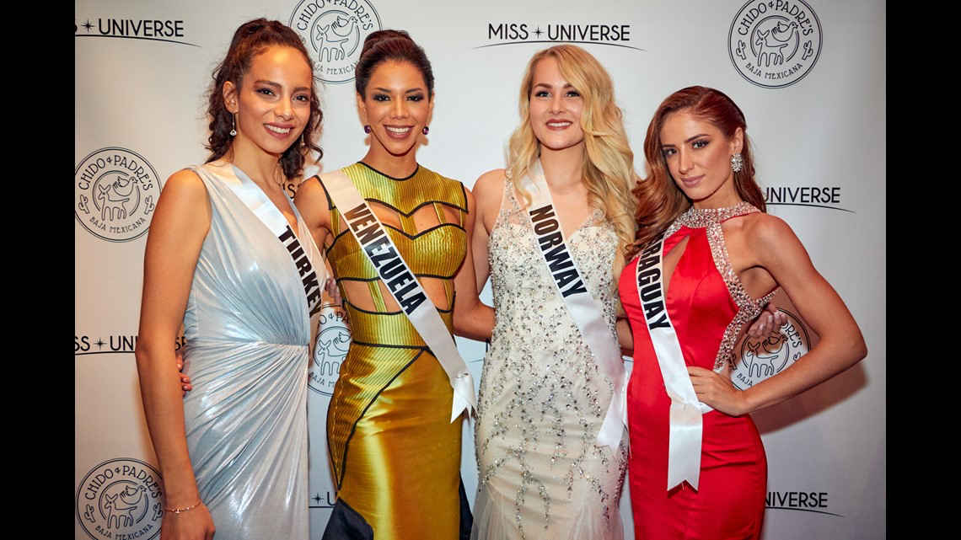
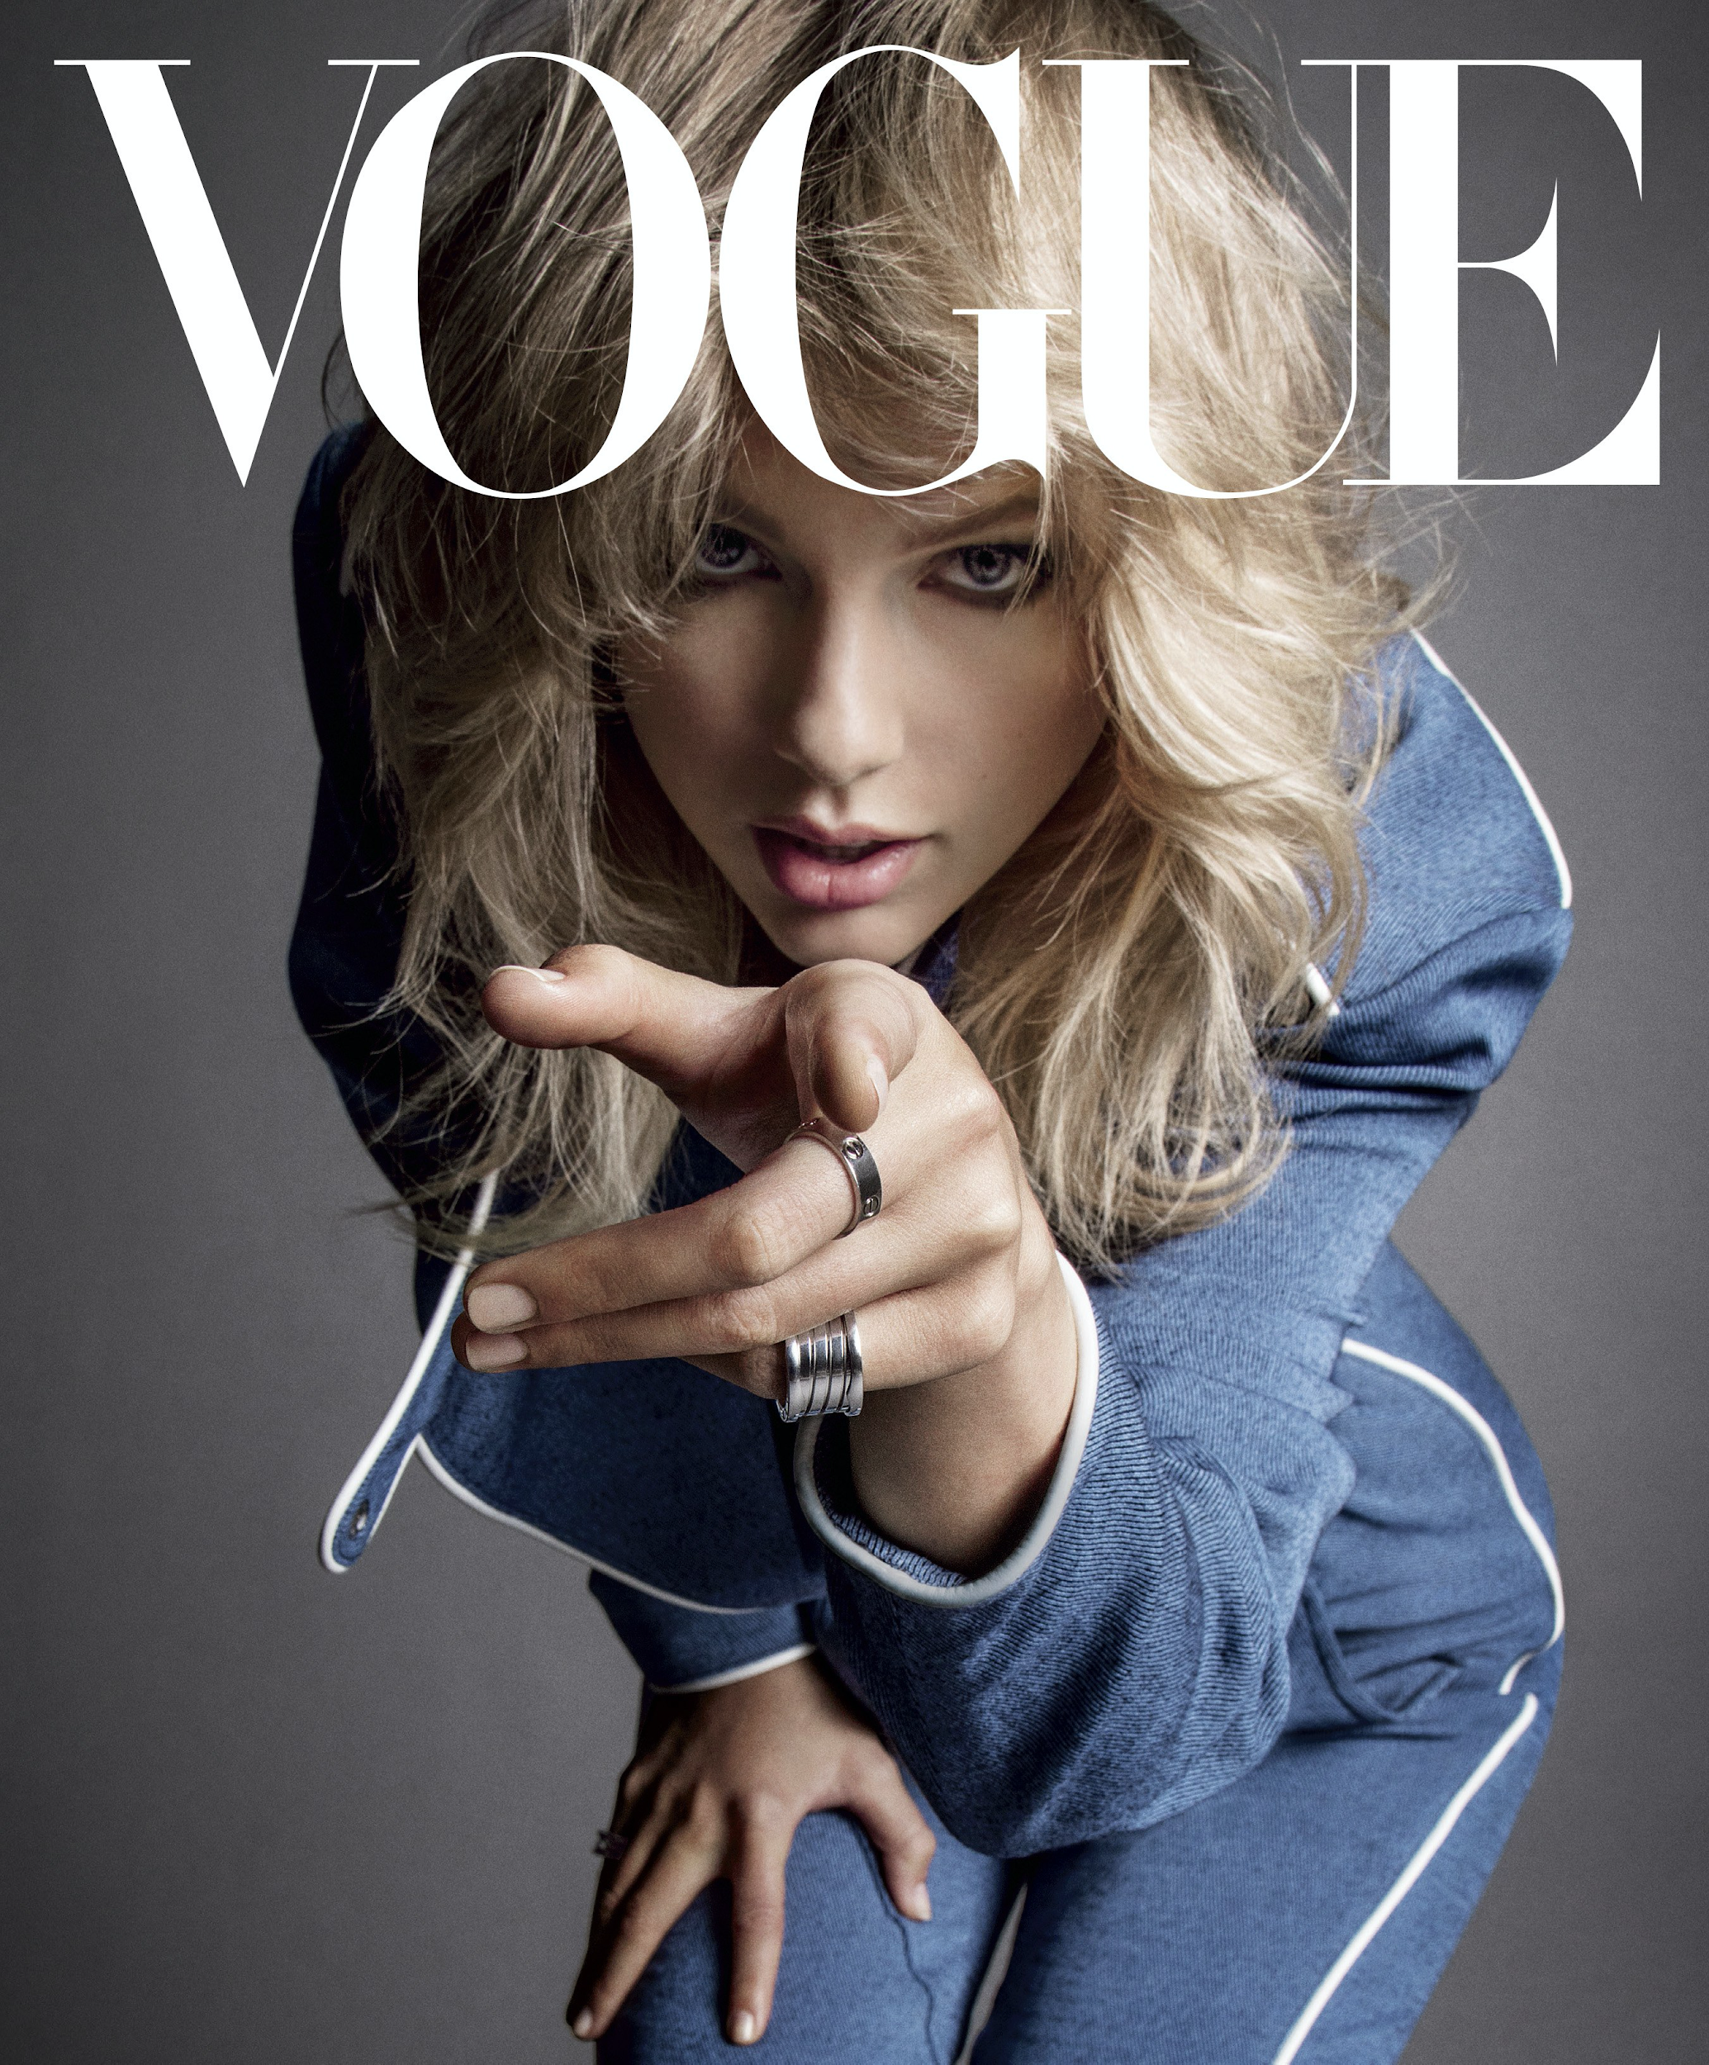

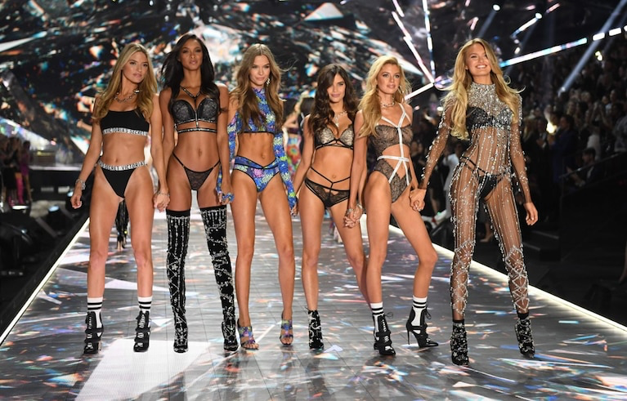
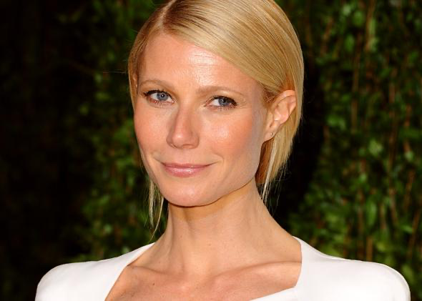
The Female Divine IN popular Culture

Slide 15
Assignment
Take three minutes to make a collage:
Your only direction is:
Compile photos that depicts the societal standards of beauty.
Why do you think we as a society have set these specific standards for beauty?
Do you feel that you fit society’s standards of beauty?
Are these images the only images that depict the female divine?

Slide 16

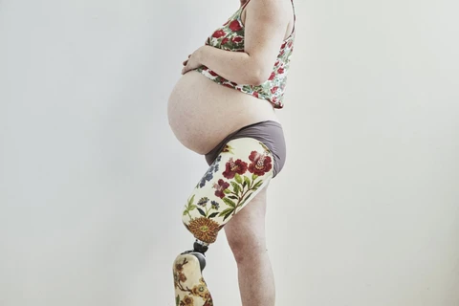
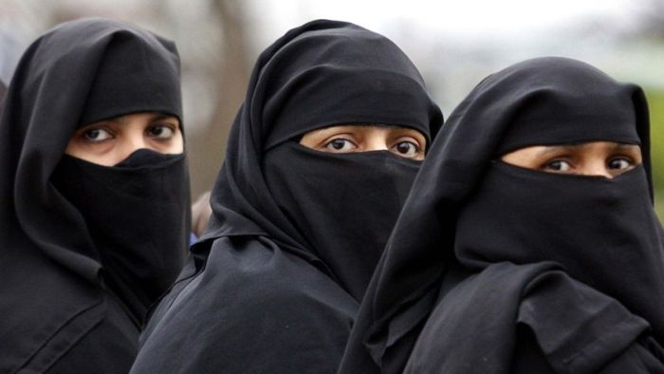
Week 4 - oppressed women in society
What does it mean to be a woman
Who can and cannot be a representation of the female divine
https://vimeo.com/393253445

Slide 17
Week 5 - presentations of personal projects
Present a small example of what the project would look like.
Students would discuss their projects in a Socratic Seminar.
Students will get into small groups and compare/contrast their thoughts on Female Divine
Students would write a page report of a representation of their ideal female devine.

Slide 18
Week 6- Final assignment/essay:
Compare and contrast the female divine in popular culture to what your individual interpretation of beauty is and tie it into the myth, Callisto and Arcas, we discussed in class.
The essay should be a minimum of 3-4 pages in length and should include quotations/references to the myth.
Due via email AND in person before the commencement of the following class.

Slide 19
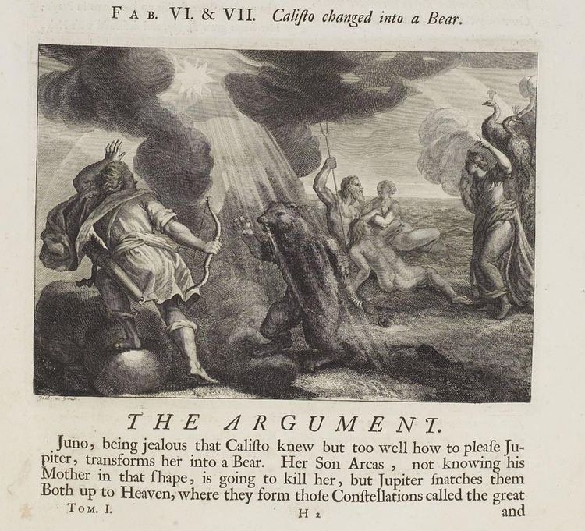
The female divine-week 2

Slide 20
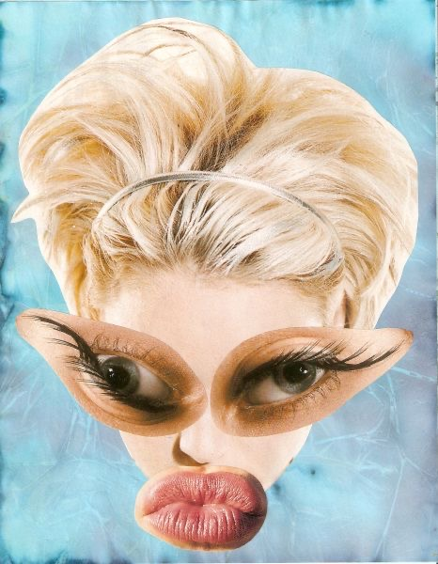

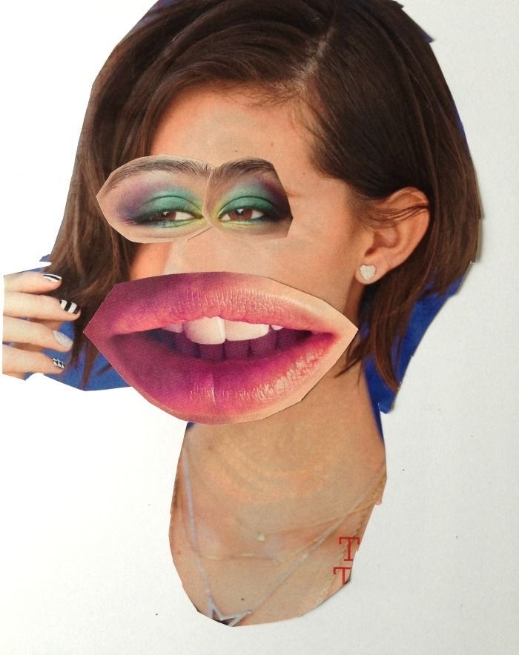
Female divine in popular culture-week 3

Slide 21

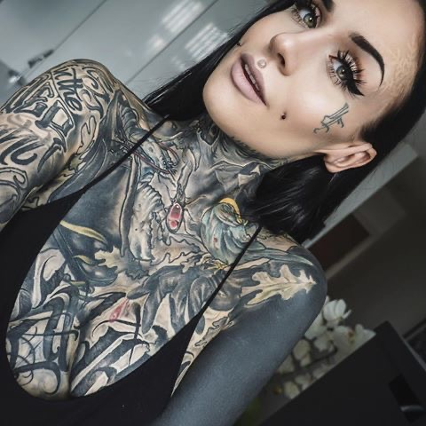
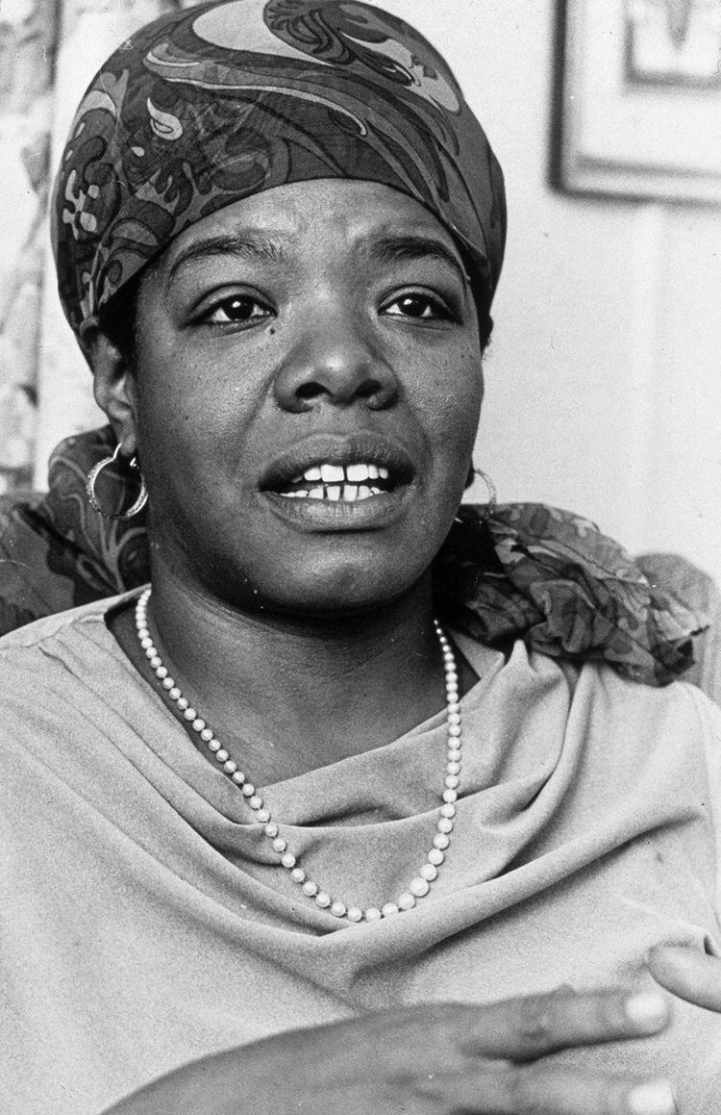
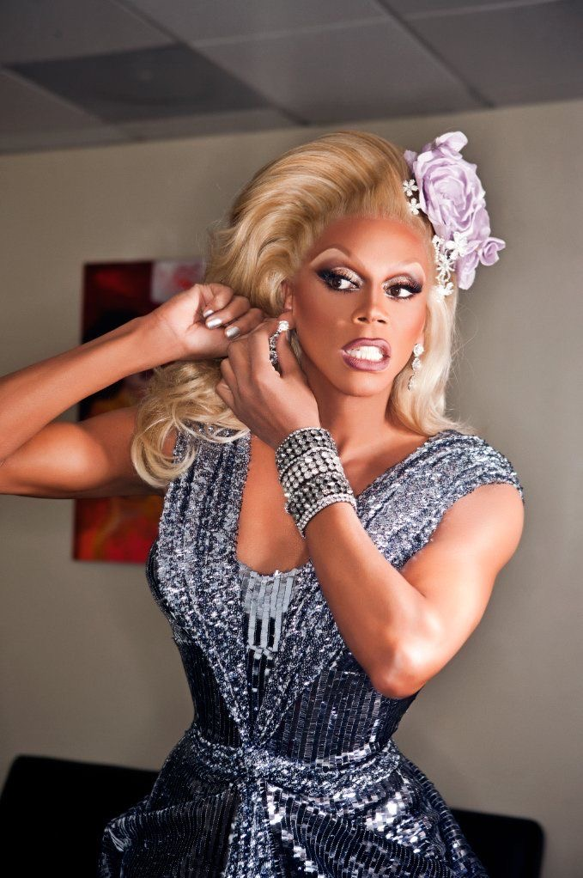
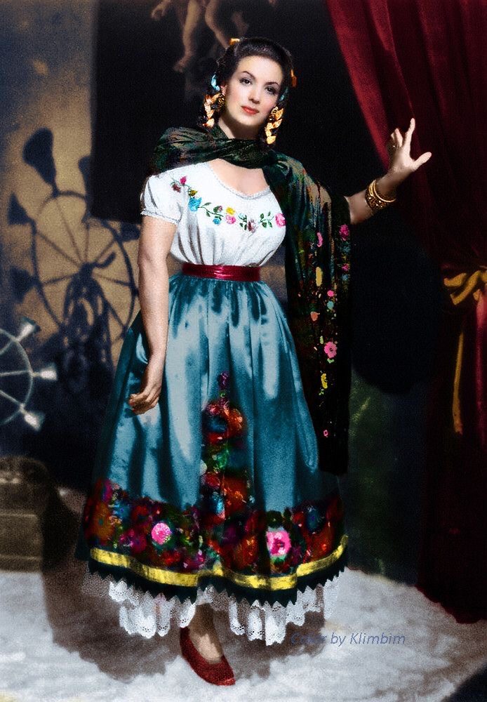
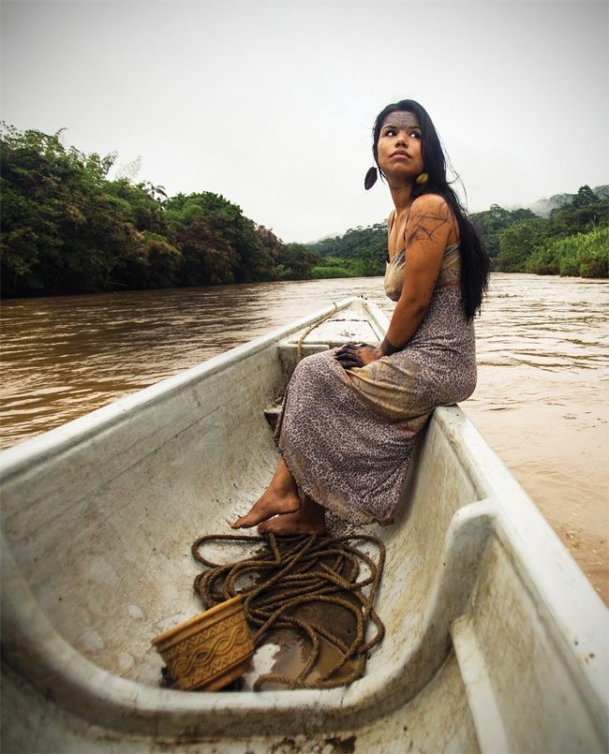
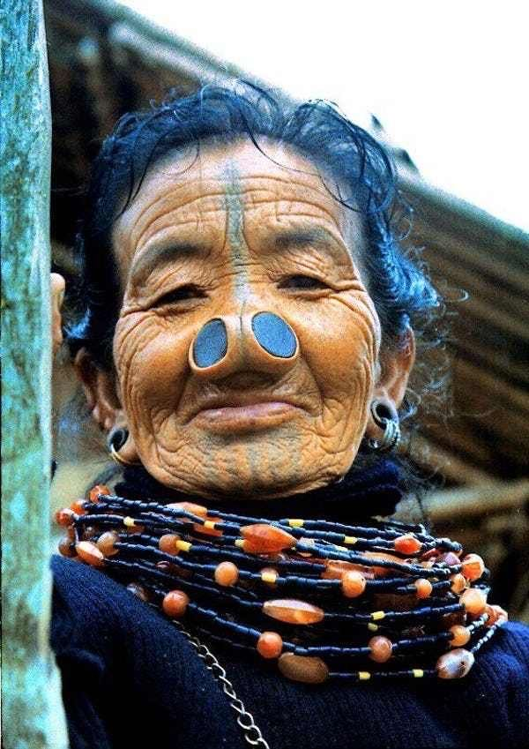
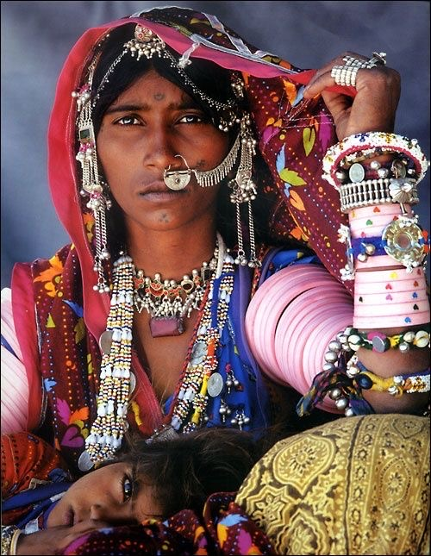
Personal projects- week 5

Slide 22
Learning outcome of essay:
Students will write a thoughtful and insightful thesis, main idea, position or claim that is sustained throughout the paper.
Students will address the topic set forth in the assignment and address all aspects of the writing task.
Students will provide support for main points with reasons, explanations and examples from lectures/reading.
Students will demonstrate proper organization of paragraphs and overall essay structure.
Students will write using well structured sentences, fitting word choice and tone to achieve overall purpose.
Students will write an essay using correct syntax, grammar, punctuation, spelling and format.

Slide 23
Essay grading scale:
An A (100-90 points) paper:
Student successfully answers the essay prompt by strongly articulating the similarities and/or differences between what (for example/not limited to) actions, features, characteristics or personality they attribute to beauty, as opposed to, what is beautiful/what the female divine in modern society is considered. Simultaneously, the student showcases familiarity with and understanding of the female divine in mythology/Callisto with little to no spelling or grammar mistakes throughout paper.

Slide 24
Works cited
Barthes, Roland. Mythologies. Cape, 1974.
Handout: https://www.getty.edu/education/teachers/trippack/downloads/vsi_talkshow_previsit_deities_villa.pdf (Ani)
Leonard, Scott A., and Michael McClure. Myth and Knowing: an Introduction to World Mythology. McGraw Hill, 2007. (Ani)
Satchitananda, Sunyata. “The Divine Feminine.” Sunyata Satchitananda, Sunyata Satchitananda, 18 June 2019, sunyatasatchitananda.com/divine-feminine/. (Ani)

